Slide 1
Science 9
Unit 4: Ecology
Lesson 1: Water Cycle

Slide 2
Objectives
By the end of the lesson you should be able to:
Describe what the water cycle is
Draw the water cycle
Explain how the water cycle relates to your planet problem

Slide 3
Water Facts!
30% of fresh water is in the ground
1.7% of the world’s water is frozen and therefore unusable
Approximately 400 billion gallons of water are used in the United States per day
Nearly one-half of the water used by Americans is used for thermoelectric power generation
In one year, the average American residence uses over 100,000 gallons (indoors and outside)
About 6,800 gallons of water is required to grow a day’s food for a family of four
To create one pint of beer it takes 20 gallons of water
780 million people lack access to an improved water source
In just one day, 200 million work hours are consumed by women collecting water for their families
1/3 what the world spends on bottled water in one year could pay for projects providing water to everyone in need
Unsafe water kills 200 children every hour

Slide 4
Water States
Gas
condensation
Liquid
Freezing
Solid
Sublimation
Deposition
Evaporation
Melting

Slide 5
Water cycle
AKA: the Hydrologic cycle
We know that Water changes states between solid, liquid and gas
How does water change state on earth?

Slide 6
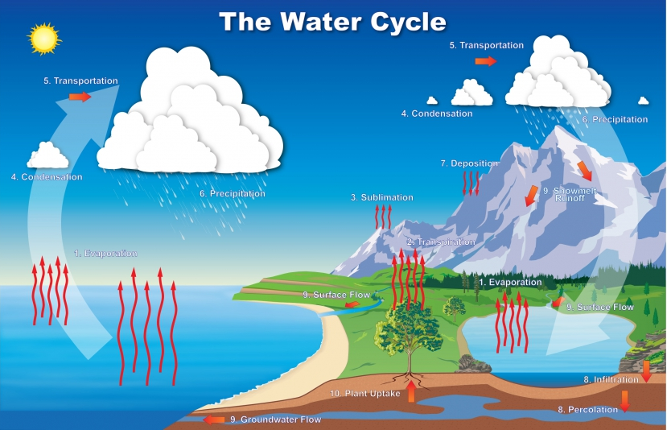
Water Cycle
5. Transportation
5. Transportation
4. Condensation
6. Precipitation
7. Deposition
4. Condensation
6. Precipitation
3. Sublimation
9. Snowmelt Runoff
1. Evaporation
2. Transpiration
1. Evaporation
9. Surface Flow
9. Surface Flow
8. Infiltration
10. Plant Uptake
8. Percolation
9. Groundwater Flow

Slide 7
The water vapour song!

