Slide 1
Science 9
Chem 7: Covalent Compounds

Slide 2
Objectives
By the end of the lesson you should be able to:
Describe how covalent compounds are formed
Explain how covalent compounds are both similar and different from ionic compounds

Slide 3
Covalent Compounds
What happens when 2 non-metals try to bond when they both need to gain electrons?
They have to share electrons to gain full outer shells!
A molecule is formed when a group of atoms bond together by sharing electrons

Slide 4
Covalent Bonding Example: Water (H₂O)
H
p⁺=1
nº=0
Draw a Bohr model diagram for hydrogen and oxygen
How many valence electrons does hydrogen have?
1
How many valence electrons does oxygen have?
6
When hydrogen and oxygen bond how many electrons does oxygen need?
2
How many electrons can hydrogen give to oxygen?
1
So how many hydrogen atoms are needed to make water?
2
O
p⁺=8
nº=8

Slide 5
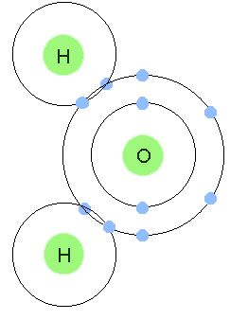
Notice that the outer shells of each atom are overlapping to show and that the electrons are in that “shared zone”

Slide 6
Ionic Vs Covalent Compounds
Fill in the chart below
IONIC COVALENT
Similarities
Differences

Slide 7
Your Turn!
Practice distinguishing between ionic and covalent compounds

